Slide 1
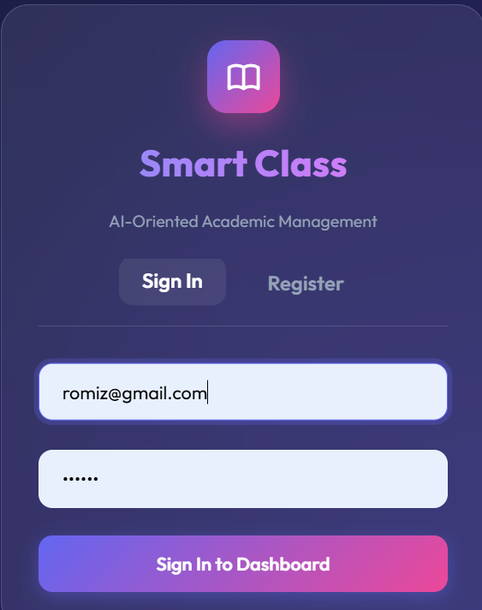
AI-Oriented Class Management System for Crisis and Disaster Situations
ENTERPRISE-GRADE EDUCATIONAL PLATFORM
Platform Type
: Full-Stack
Developed by Romiz Khan(ID : IT22045)
Streamlining Education for All

Slide 2

AI CLASS MANAGEMENT SYSTEM
Contents
Executive Summary
03
Core Technologies
04
User Roles
05
Architecture
06
Features
07
Database Design
08
Mobile-First UI
09
AI Integration & Results
10
Full-Stack Educational Platform

Slide 3


AI CLASS MANAGEMENT
Executive Summary
A full-stack, enterprise-grade educational platform streamlining operations between Administrators, Faculty, and Students. Built with modern, scalable architecture featuring premium Mobile-First Glassmorphism UI for flawless cross-device experience.
Page 3 of 10

Slide 4




TECH STACK
Vanilla JavaScript
(CORE LOGIC)
HTML5
Glassmorphism CSS
(Structure)
(UI Design)
Core Frontend
Technologies
AI-Oriented Class Management System

Slide 5


AI CLASS MANAGER
User Roles
Administrator
The Administrator role provides complete system management and oversight capabilities. Admins can manage user accounts, configure system settings, monitor platform activity, and ensure smooth operations across the entire educational ecosystem.
Key Responsibilities
User account creation and management, system configuration, data oversight, security monitoring, and coordinating between Faculty and Students to maintain an efficient learning environment.
AI-Oriented Class Management System

Slide 6
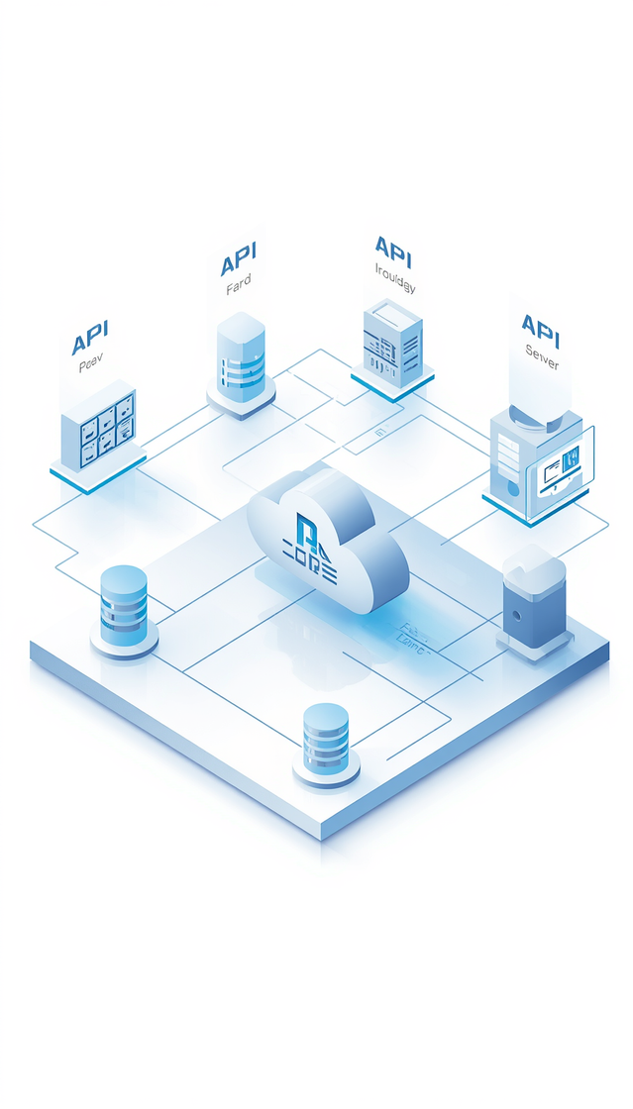
AI CLASS SYSTEM
Architecture
Built on a modern, scalable architecture featuring Aiven MySQL cloud database for reliable data persistence, RESTful API design with Express.js for seamless communication, and a modular component structure enabling easy maintenance and future expansion.

Slide 7




AI CLASS SYSTEM
Key Features
PDF Exam Script Handling with Multer for seamless file uploads, Real-time Dashboard analytics, and Cross-device Responsive Design for flawless mobile-first experience.
www.aiclassmanagement.com

Slide 8


AI CLASS SYSTEM
Development Journey
Phase 1-3
Planning & Architecture: Requirements gathering, database schema design, and system architecture. Backend Setup: Node.js/Express API development with Aiven MySQL integration.
Phase 4-6
Frontend Design: Mobile-first Glassmorphism UI with vanilla JS. AI Integration: Smart features for class management. Testing & Deployment: QA and cloud deployment.

Slide 9

AI CLASS MANAGEMENT
System Performance Metrics

Slide 10
Thank You!
FOR YOUR ATTENTION
Visit our platform today 🚀

